Slide 1
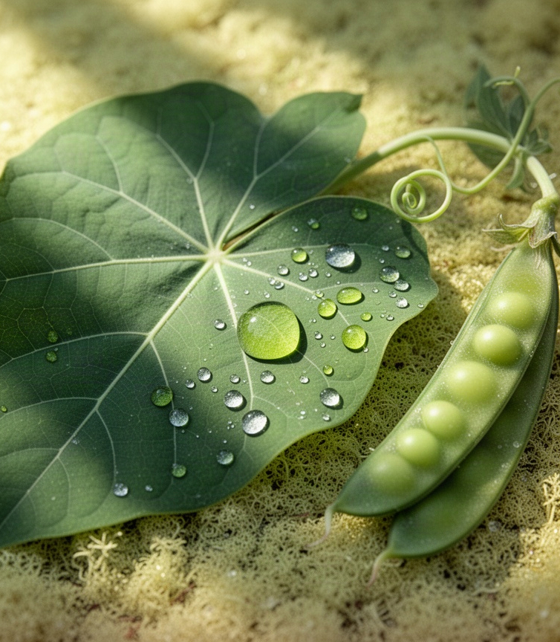
Photosynthesis Basics
How plants convert light into stored chemical energy
A foundational view of inputs, stages, and products

Slide 2
Learning Roadmap
Foundations And Essential Vocabulary
Historical Discoveries And Reaction Stages
Chloroplast Structure And Energy Transfer
Light Absorption And Equation Balance
Limits, Applications, And Future Growth

Slide 3
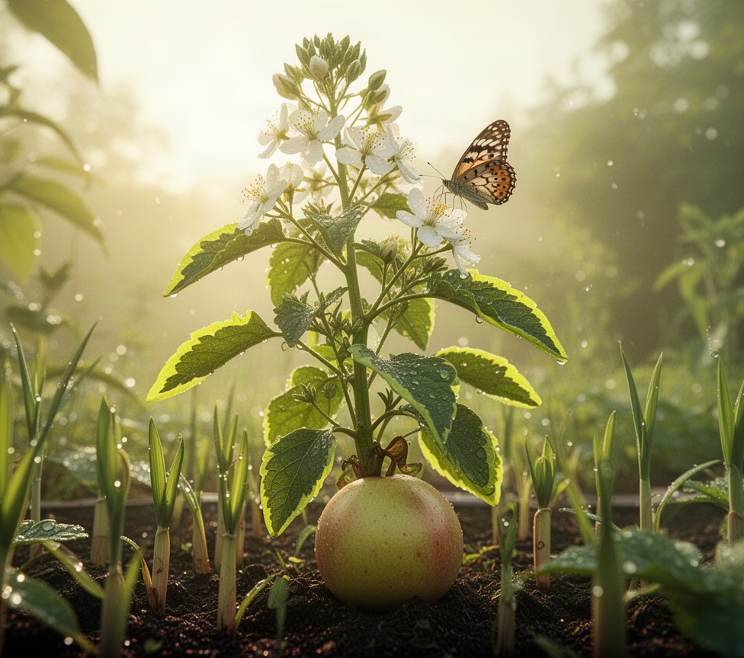
Why It Matters
  Photosynthesis supplies sugars
Photosynthesis supplies sugars that power plant growth, from building new leaves and roots to producing flowers, fruit, and seeds. Those stored sugars provide chemical energy for metabolism when light is unavailable and furnish the carbon-based materials used to build plant tissues. The process therefore underpins crop yields, forest growth, and the renewable biomass that supports countless organisms. By turning sunlight into food, plants form the productive base of most land ecosystems and many aquatic food webs.

Slide 4
Core Vocabulary
  Chlorophyll
Chlorophyll is the green pigment that captures sunlight. Its energy excites electrons, beginning the light-driven reactions that power photosynthesis.
  Chloroplast
Chloroplasts are plant-cell organelles where photosynthesis occurs. Their internal membranes organize light capture and energy-making reactions.
  Glucose
Glucose is an energy-rich sugar produced from carbon dioxide. Plants use it for fuel, growth, storage, and building new tissues.
  Stomata
Stomata are tiny leaf pores that admit carbon dioxide. They also release oxygen and regulate water loss as photosynthesis proceeds.

Slide 5
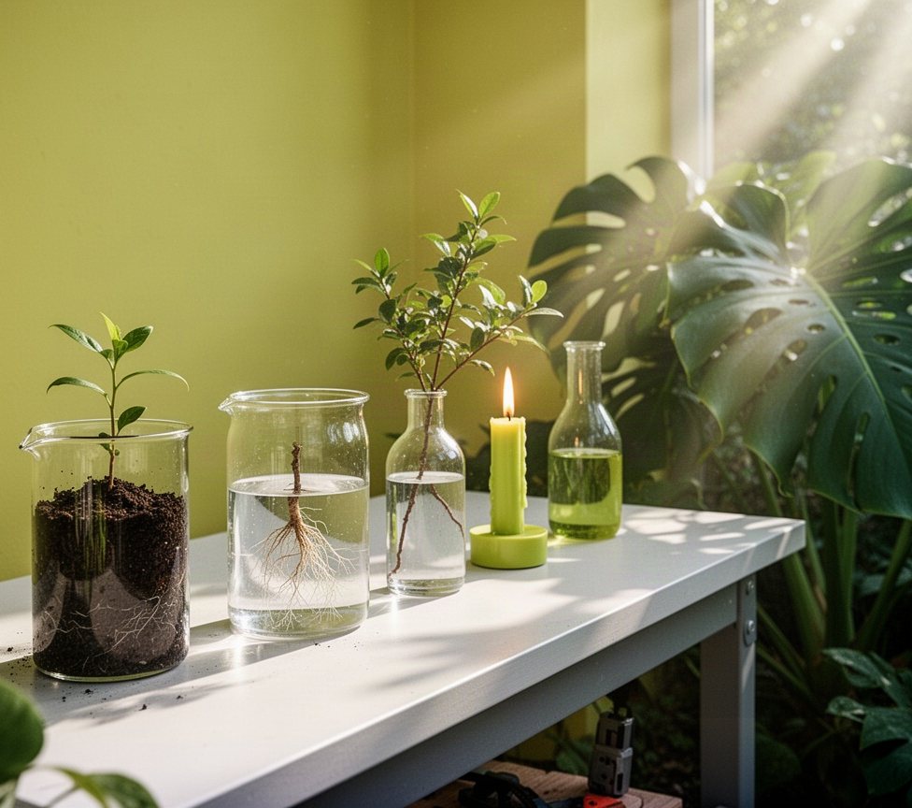
Discovery Timeline
van Helmont shows plant mass largely comes from water, not soil
Priestley demonstrates that plants restore air altered by burning candles
Ingenhousz finds that green plants release oxygen only in light
Sachs links starch formation in leaves to illuminated green tissues
s
Modern research connects gas exchange and light capture to cellular reactions

Slide 6
Two Reaction Stages
  Light-dependent reactions
Capture sunlight in thylakoid membranes, the chloroplast’s internal membrane network.
Use water as an electron source, releasing oxygen as a byproduct.
Convert absorbed light energy into ATP and NADPH, two temporary energy carriers.
Supply the chemical energy and reducing power needed for carbon fixation.
Depend directly on light, so their output rises and falls with available illumination.
  The Calvin cycle
Occurs in the stroma, the fluid-filled region surrounding thylakoid membranes.
Uses ATP and NADPH from the light reactions to power carbon dioxide fixation.
Builds small carbon compounds that are rearranged into sugars and other organic molecules.
Regenerates the starting carbon acceptor so the cycle can continue processing CO₂.
Does not absorb light directly, yet relies on energy made during illuminated reactions.

Slide 7
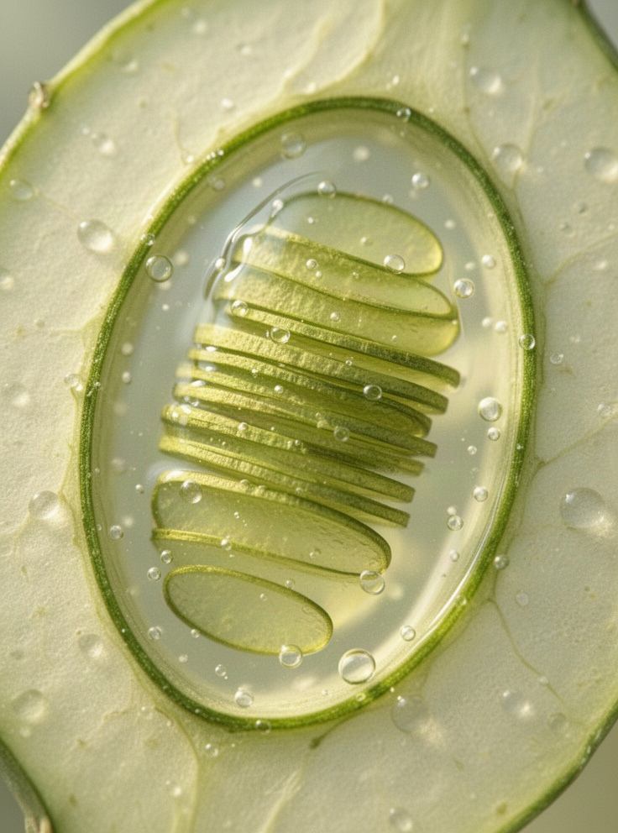
Chloroplast Workspace
  Thylakoids
Thylakoids are flattened membrane sacs arranged in stacks called grana. Their chlorophyll pigments capture light, while embedded protein complexes transfer electrons and build a proton gradient. This membrane workspace produces ATP and NADPH, the energy carriers that power carbon fixation.
  Stroma
The stroma is the fluid-filled space surrounding the thylakoids. Here, enzymes use ATP and NADPH to combine carbon dioxide into carbohydrate-building molecules through the Calvin cycle. This compartment links captured light energy to the synthesis of sugars that support plant growth.

Slide 8
Chemical Energy Flow
  Light energy
Light energy absorbed by chlorophyll raises electrons to a higher-energy state. Specialized proteins capture these excited electrons instead of letting the energy dissipate as heat, beginning the conversion of sunlight into usable chemical potential.
  Energy carriers
Electron transport uses the captured energy to build ATP and NADPH. ATP supplies immediate energy for cellular work, while NADPH carries high-energy electrons that can power the construction of sugar molecules.
  Carbon fixation
ATP and NADPH transfer their stored energy to carbon fixation, where carbon dioxide is assembled into carbohydrate. The resulting sugars preserve solar energy in chemical bonds and provide material for plant growth, storage, and metabolism.

Slide 9
Absorption Evidence
Chlorophyll pigments capture blue and red wavelengths most effectively, supplying the energy that initiates photosynthesis. Absorption is weaker across much of the green region, so more green light is reflected or transmitted through the leaf. That reflected light is what gives healthy foliage its familiar green appearance. The contrast also explains why light sources rich in blue and red wavelengths are often favored when researchers study plant growth responses.

Slide 10
Equation Accounting
6 CO₂
6 H₂O
1 C₆H₁₂O₆
  Carbon Dioxide
Six carbon dioxide molecules supply the six carbon atoms needed to build one glucose molecule during photosynthesis.
  Water Input
Six water molecules provide hydrogen and electrons, while oxygen atoms are released as molecular oxygen.
  Glucose Output
One glucose molecule stores captured light energy in chemical bonds, alongside six molecules of oxygen.

Slide 11
Process Constraints
  Light availability
Light can limit photosynthesis when intensity is low, days are short, or leaves are shaded. As light increases, plants capture more energy until another requirement becomes scarce. Excessive light may also stress tissues if heat and water loss rise faster than the plant can respond.
  Carbon dioxide supply
Carbon dioxide is the raw material used to build sugars. When air movement is poor or stomata close to conserve water, less carbon dioxide reaches leaf cells. Raising carbon dioxide can increase photosynthesis only when light, temperature, and nutrients are already adequate.
  Temperature balance
Temperature affects the enzymes that drive carbon fixation. Cool conditions slow reactions, while excessive heat can disrupt enzymes and encourage stomata to close. The limiting factor changes with growing conditions, so improving one condition may reveal a different constraint.

Slide 12

Environmental Limits
  Water availability
Dry soil limits water delivery to leaves, causing stomata to close and reducing the carbon dioxide available for photosynthesis.
  Heat stress
Excessive heat can damage photosynthetic enzymes and increase water loss, so energy capture falls even under bright light.
  Gas exchange
Plants regulate stomata to balance carbon uptake with water conservation; shade also lowers light energy available for sugar production.

Slide 13
Modern Cultivation
  Controlled environments
Indoor farms regulate growing conditions so plants receive stable resources regardless of outdoor weather. This creates a more predictable setting for crop development.
  Light management
LED systems provide selected wavelengths and schedules, helping growers match illumination to crop needs while reducing wasted energy and uneven growth.
  Resource delivery
Water and nutrients are supplied precisely through irrigation systems, limiting shortages and allowing roots to access a dependable balance throughout growth.
  Airflow control
Ventilation moves fresh air around leaves, moderates heat and humidity, and helps maintain conditions that support consistent, healthy plant growth.

Slide 14
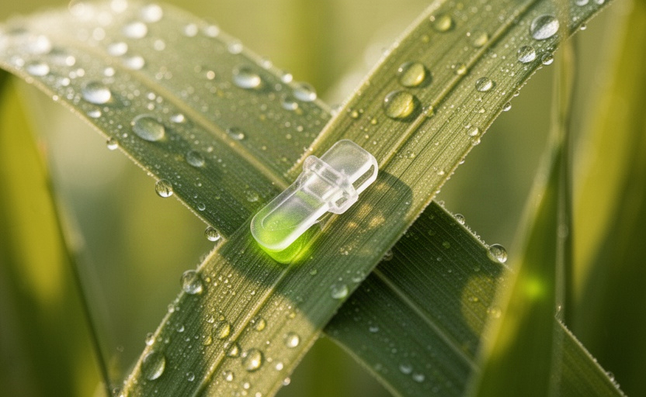
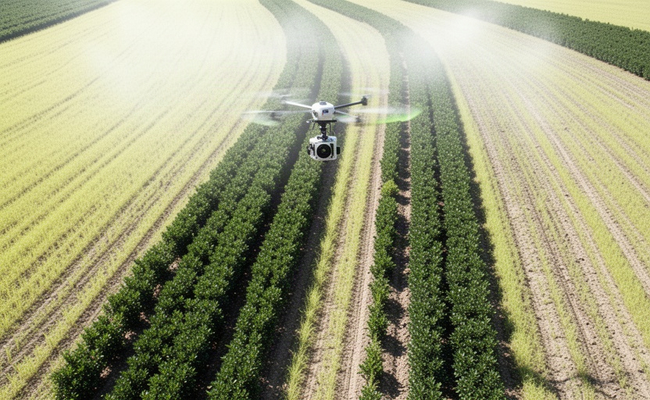
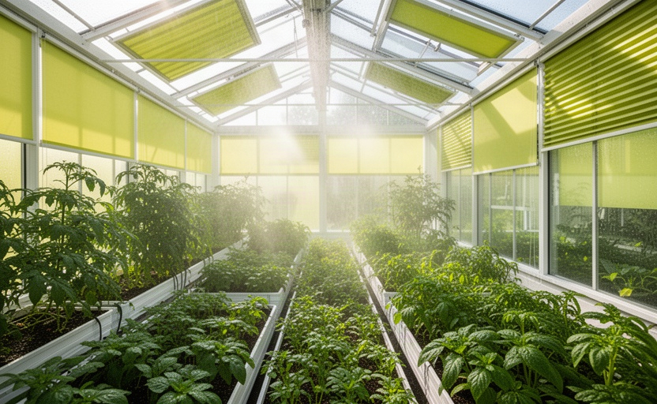
Monitoring Tools
  Leaf Sensors
Leaf-mounted sensors track temperature and moisture, revealing how plants respond to light, heat, and water conditions.
  Canopy Imaging
Imaging systems map canopy color and density, helping growers spot uneven growth or early stress across crop rows.
  Timely Adjustments
Continuous measurements guide light, irrigation, and ventilation changes before environmental stress limits photosynthesis.

Slide 15
Applied Practices
  Light exposure
Match light intensity, duration, and spectrum to each crop and growth stage. Seedlings need gentle, consistent illumination, while mature leafy crops can use stronger light to build biomass. Adjust fixtures as plants grow so leaves receive usable energy without bleaching, heat stress, or wasted electricity.
  Water conditions
Maintain reliable root-zone moisture so stomata can stay open and photosynthesis can proceed. Avoid both drought and saturated media: dry plants conserve water by closing stomata, while waterlogged roots lose oxygen and cannot support healthy uptake. Check irrigation timing, drainage, and substrate moisture regularly.
  Carbon dioxide balance
Keep carbon dioxide available around actively growing leaves, especially in enclosed production spaces. Good airflow prevents depleted pockets near dense foliage and also moderates humidity. Supplementation is useful only when light, water, nutrients, and temperature are already appropriate; otherwise it adds cost without improving growth.

Slide 16
Improving Photosynthesis
  Controlled conditions
Controlled environments reduce avoidable limits on photosynthesis by maintaining steady light, temperature, water, and nutrient supply. In greenhouses and growth chambers, growers can prevent heat stress, drought, or abrupt shading from interrupting carbon fixation. Stable conditions help leaves keep stomata open and use absorbed light more consistently.
  Breeding strategies
Plant breeding seeks varieties that turn light and carbon dioxide into biomass more efficiently. Researchers select traits such as improved leaf architecture, faster recovery after bright light, and stronger tolerance of heat or water stress. These traits can help crops sustain productive photosynthesis across changing field conditions and support reliable yields.
  Carbon concentration
Carbon-concentrating strategies raise carbon dioxide levels near the enzymes that build sugars, reducing wasteful photorespiration. Some plants already use this advantage through specialized pathways, while research explores how similar features could benefit major crops. The goal is to keep carbon fixation efficient when temperatures rise or carbon dioxide is scarce inside leaves.

Slide 17
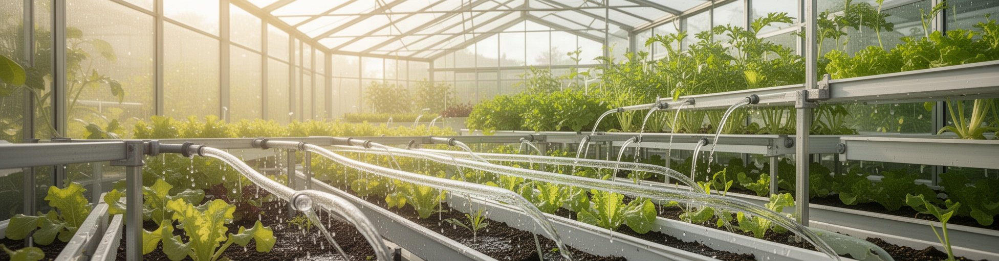
Controlled Growth
  Photosynthesis conditions
Greenhouses and vertical farms manage light, water, temperature, and carbon dioxide to keep plant conditions steady. Timed lighting, irrigation, ventilation, and carbon dioxide delivery reduce daily swings, helping crops maintain reliable photosynthetic activity and convert absorbed light into chemical energy more consistently.

Slide 18
Key Takeaways
Photosynthesis converts light, water, and carbon dioxide into glucose and oxygen.
Chloroplasts capture light energy and organize the reactions that store it.
Glucose preserves captured energy for growth, repair, and the wider food web.
Light reactions and carbon fixation work together to build chemical energy.
Water, carbon dioxide, temperature, and light availability determine the process rate.

